Slide 1




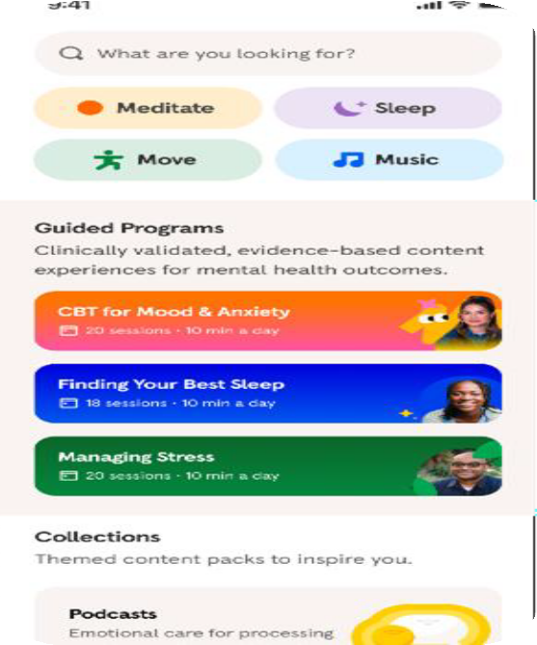
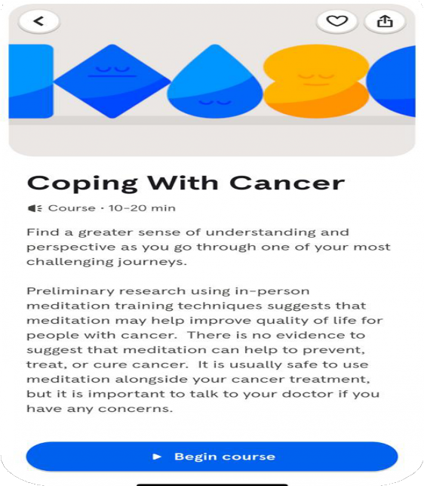
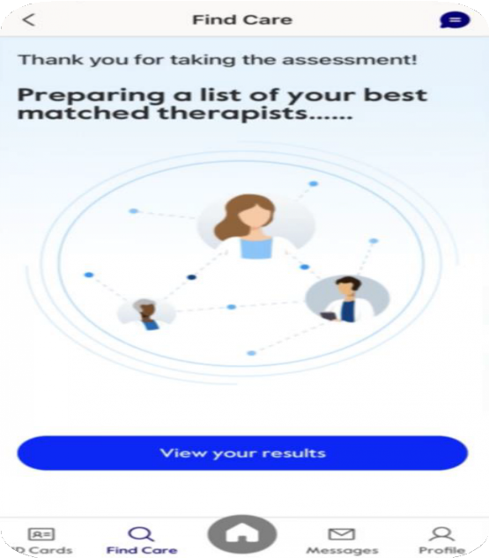
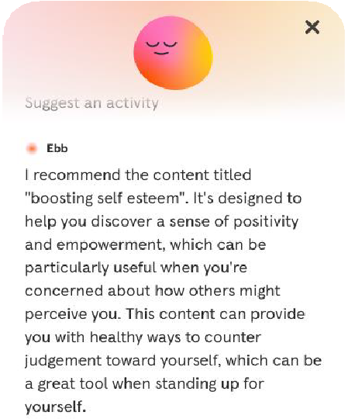

Bringing everyday mental health support to millions
for
997234
Neurodiversity
Self-guided tools for prevention and earlier engagement
Exclusive content for Cigna Healthcare customers
Seamless connection between myCigna and Headspace
AI-powered
support with Ebb
First national health plan to partner with Headspace
© 2025 Cigna Healthcare
1

